Slide 1
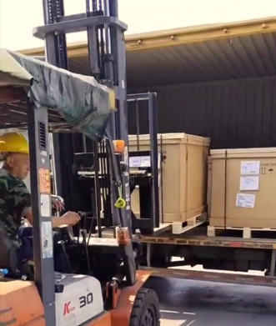

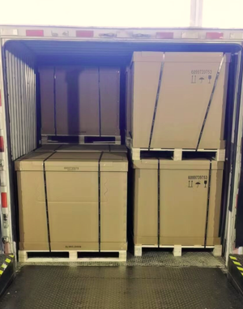
LOGISTICS
CASE STUDY - INBOUND SUPPLY CHAIN OPERATIONS – AUTOMOTIVE
Customer name: | Bosch Automotive (Thailand) Co., Ltd. /Robert Bosch Automotive Technologies (Thailand) Co., Ltd.
Project name: | Air and Ocean Inbound Operations
Volume: | +200,000 kg - airfreight
Commodity: | Automotive Parts - ELECTRIC BRAKE BOOSTER ASSY (HONDA)
Origin: | China
Destination: | Thailand
Project duration: | April 2022 – December 2022
Scope: | Scope A (Air Operations): Booking coordination Door to Airport, air-freight arrangements Exception Management – air solutions Tracking & tracing – reporting: supply chain visibility Quick response time of providing price, schedule, shipping document, and updating status Scope B (Ocean Operations): Booking coordination FCL/LCL Door to port, Ocean freight arrangements Exception Management – ocean solutions Tracking & tracing – reporting: supply chain visibility Quick response time of providing price, schedule, shipping document, and updating status

