Slide 1
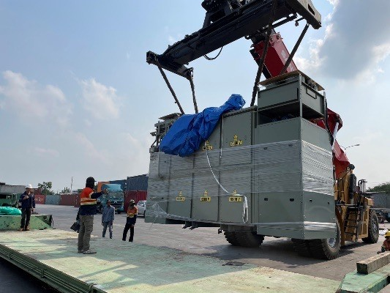
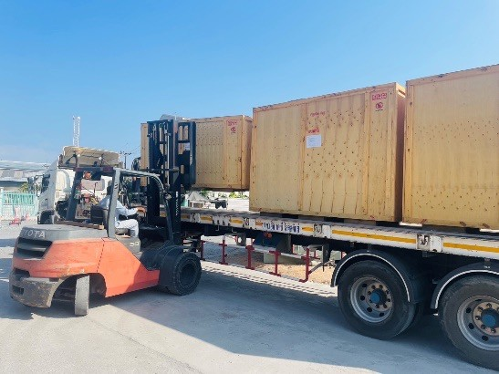
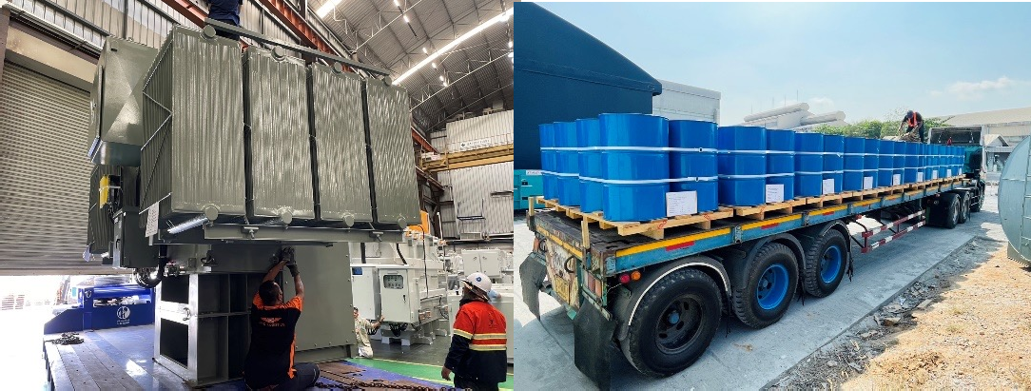
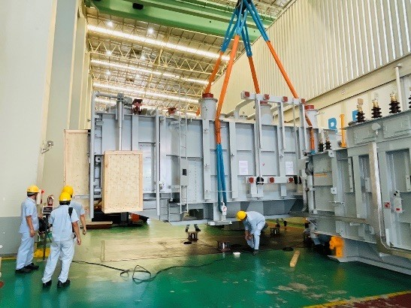
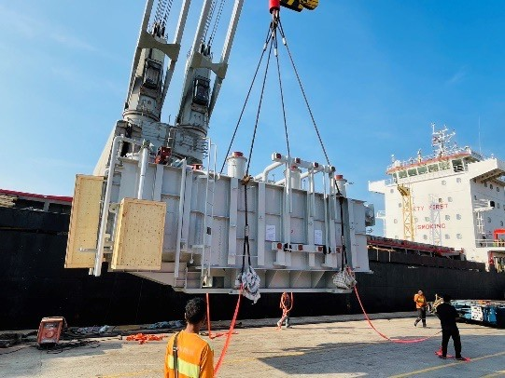
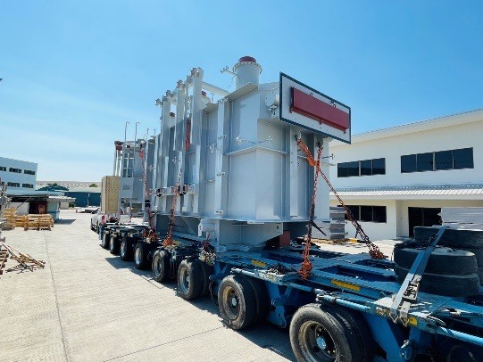
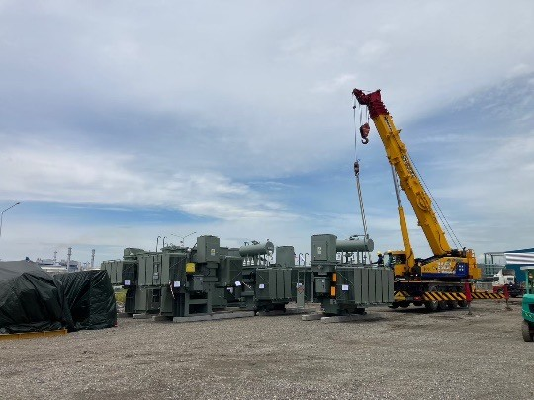
PROJECT REFERENCES
CASE STUDY - TIRATHAI PUBLIC COMPANY LIMITED
Volume: Origin:
25 transformers each between 18 – 25 tons Trucking from Tirathai Public Company Limited located in Bang Poo Industrial Estate Natureworks site at Nakornsawan
Destination:
Scope:
Lashing securing on flat racks and lowbeds
Transport on lowbed trailer
Offloading from flat racks via mobile crane
Position to place of rest / offloading and positioning in the power house
Reading shock recorders
Site supervision with our experienced FLS Project Manager

