Slide 1
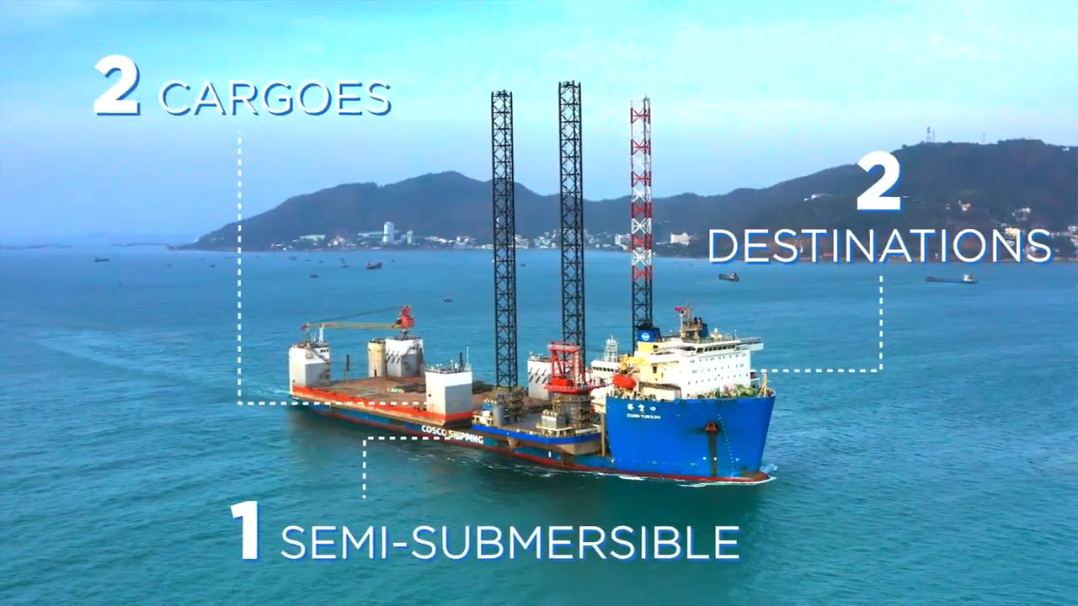
FLS PROJECTS’ CASE STUDY
Two-single Piece Shipment On Semi-submersible Vessel

