Slide 1

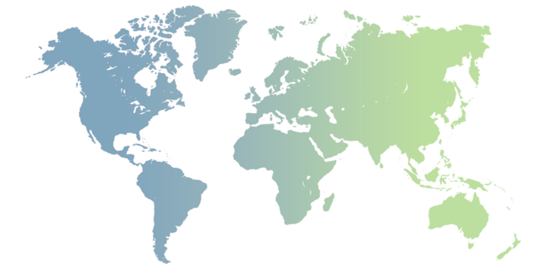





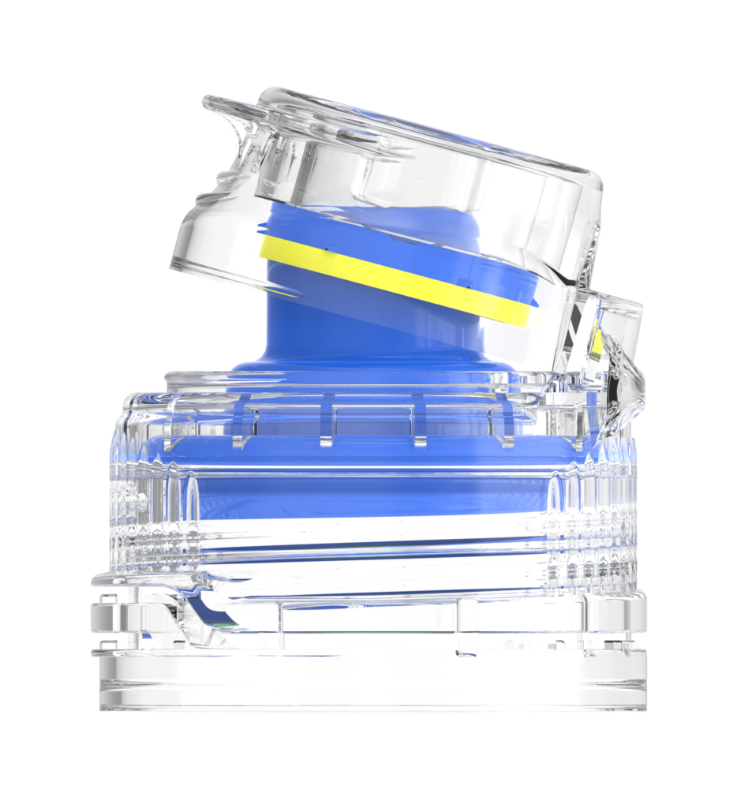
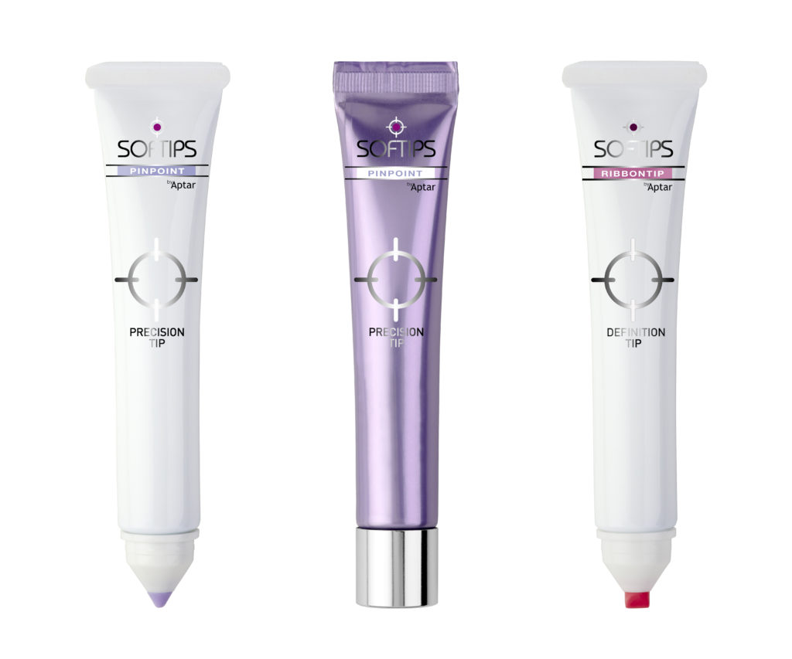


LOGISTICS
CASE STUDY - IN- AND OUTBOUND SUPPLY CHAIN OPERATIONS - INDUSTRIAL
Customer name | Aptar Group
Project Name | Ocean - Air Import & Cross Trade Operations (Tri-angle)
Commodity | Plastics for drug and consumer product dosing, dispensing and protection
Origin | Worldwide (i.e. US, DE, CZ, ES, IN, MY, ID, SG, TH, etc.)
Destination | Worldwide (i.e. US, MY, ID, SG, VN, TH, etc.)
Project duration | 2019 – Today (Ongoing)
Scope | Scope A (Customs Clearance): Exclusive contract to handle all import and export customs clearance Dedicated team of customs specialists to advice on HS codes, free trade agreements, import and export licenses, duty and taxes Provision of FTA, legalization and other consular services Scope B (Pre- and On-carriage): Exclusive contract for all in- and outbound transport Daily delivery of LCL and airfreight shipments from or to airport and seaport Daily container deliveries from & to the seaports (incl. temperature control for reefer container) Delivery solution for emergency plan of loading (changing plan in short notice) Scope C (Ocean/Air Operations): Booking coordination Door-to-port ocean & door-to-door air-freight arrangements Exception Management – Emergency air / ocean solutions Tracking & tracing – reporting: supply chain visibility Scope D (Ocean/Air Cross Trade Operations): Booking coordination, Coordinate with shipper, business controller (control tower), consignee Door-to-port ocean & door-to-airport air-freight arrangements Exception Management – Emergency air / ocean solutions Tracking & tracing – reporting: supply chain visibility

