Slide 1
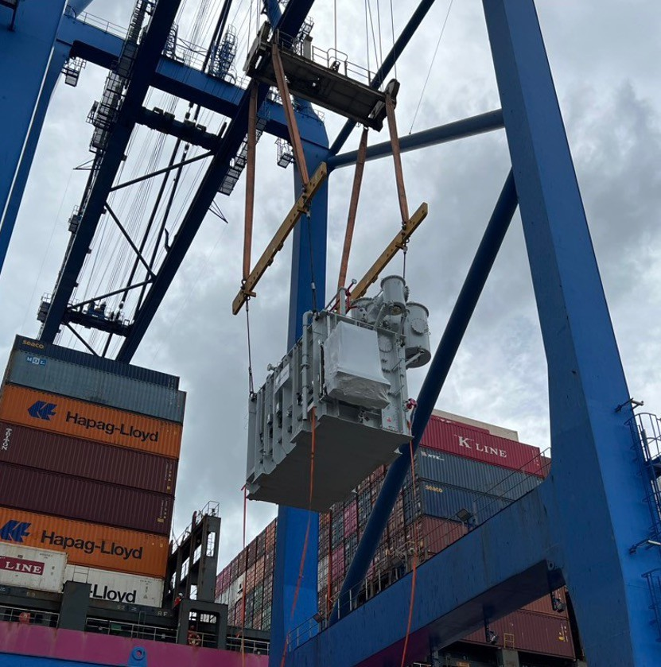
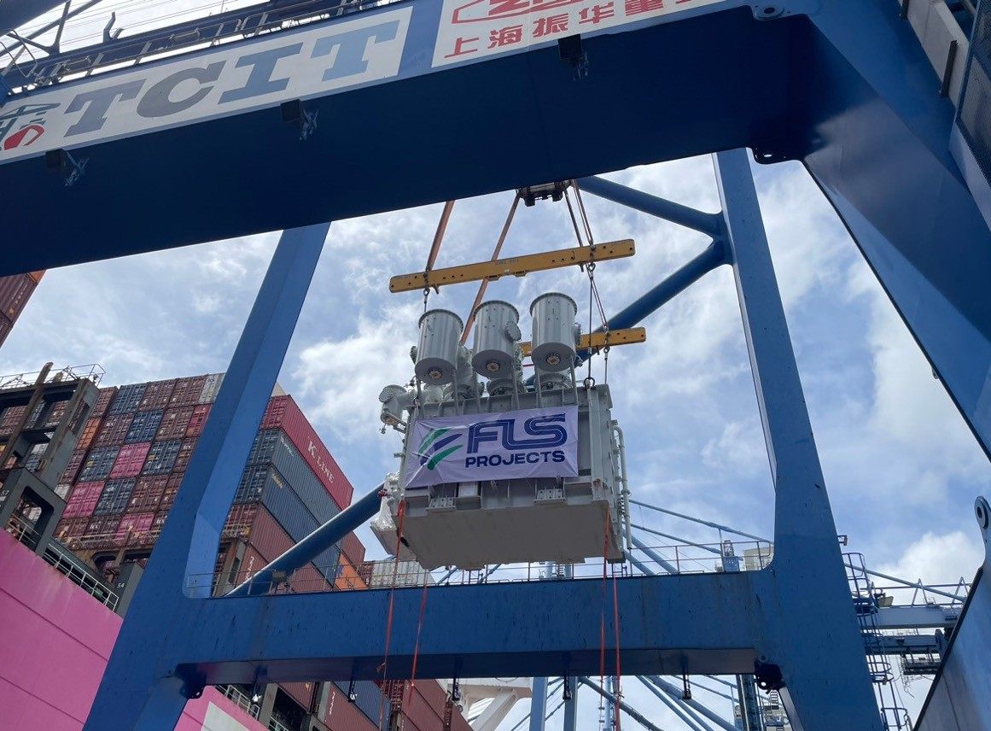
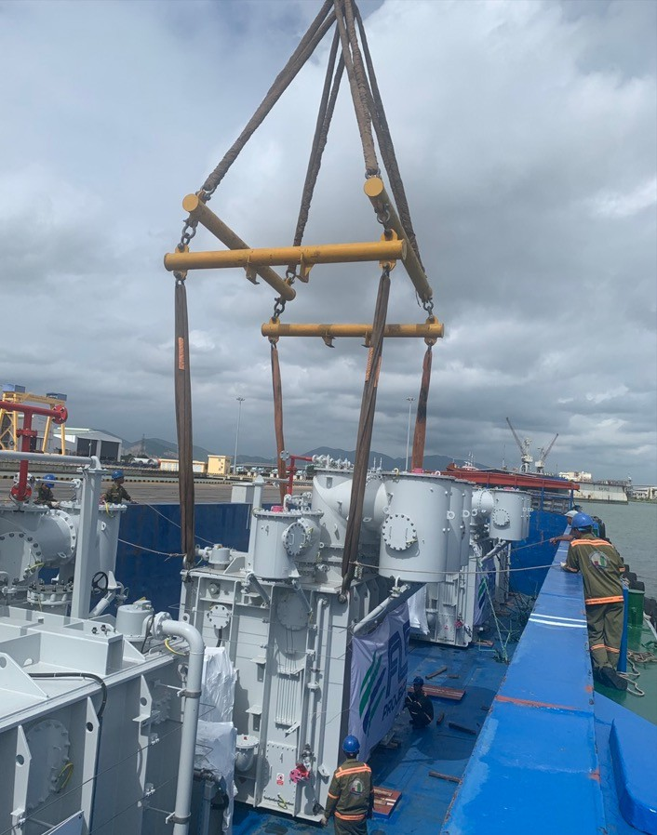
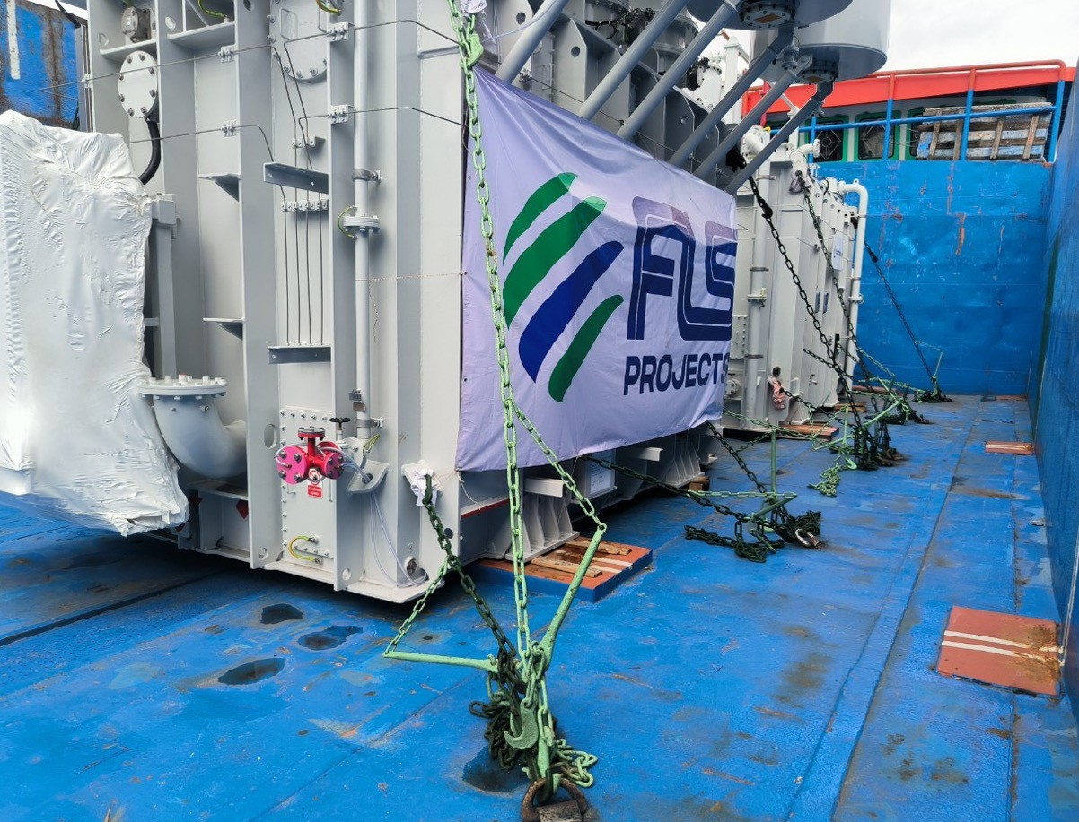
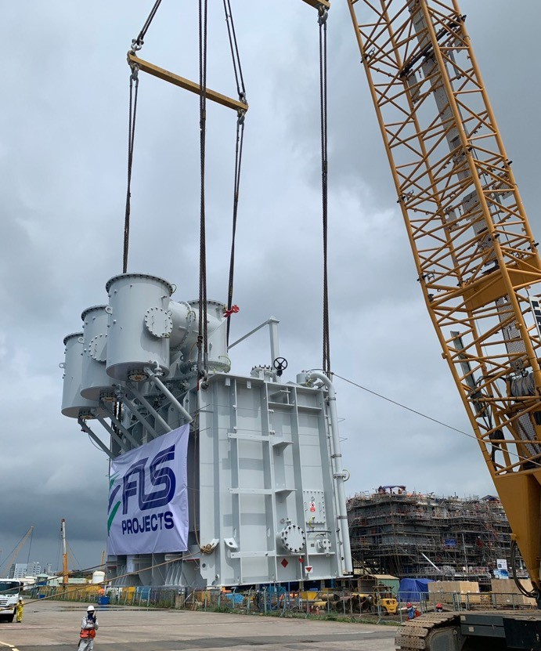
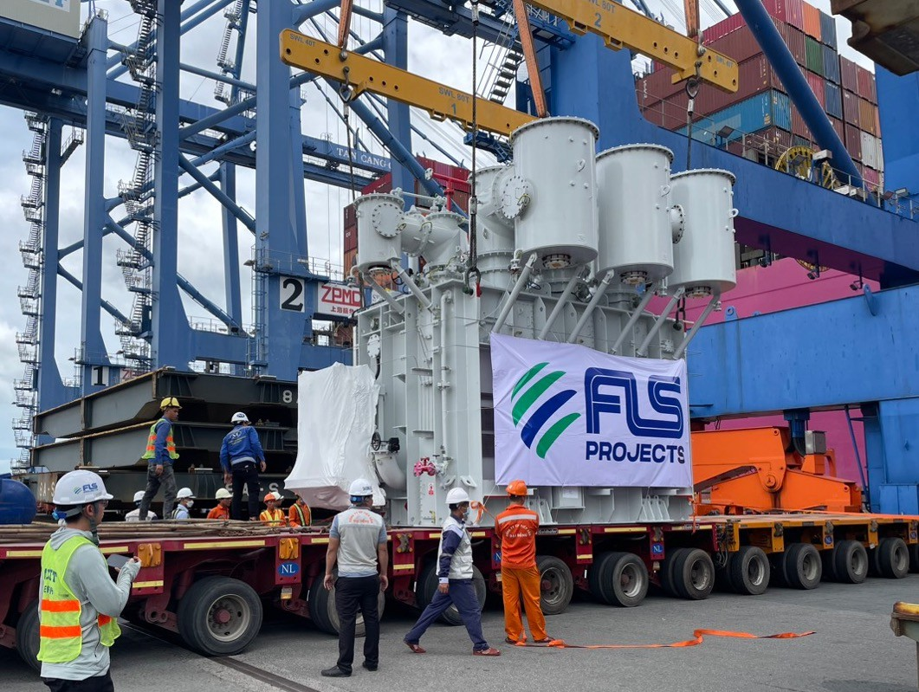
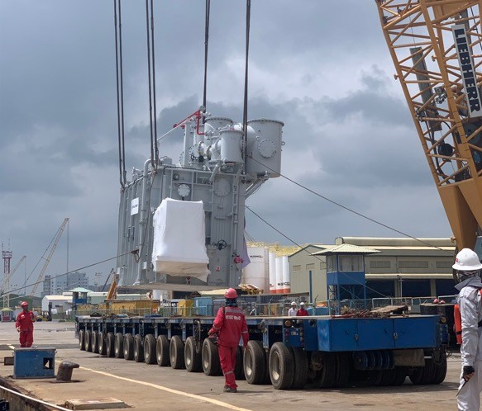
PROJECT REFERENCES
CASE STUDY –
4X TRANSFORMER EA 69.1 TONS FOR HAI LONG PROJECT
Volume: Origin: Destination:
Scope:
4x 6.12x4.37x5.16m , 69.1tons per each Rotterdam , Netherland
PTSC port, Vietnam
To receive cargo from container vessel at Container port
Loading cargo on to hydraulic axle lines
Trucking to Bason port and loading into deep hold barge via mobile cranes
Barging to PTSC port facility in Vung Tau
Loading, lashing and barging operations were all prepared by FLS Stevedores and supervised by our experienced FLS Port Captain
Lashing and secure proper for operation
Loading supervision by FLS Port Captain

