Slide 1
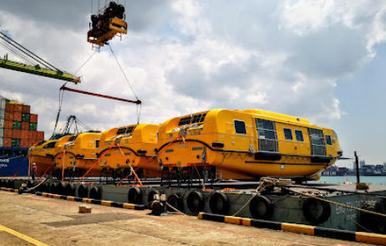
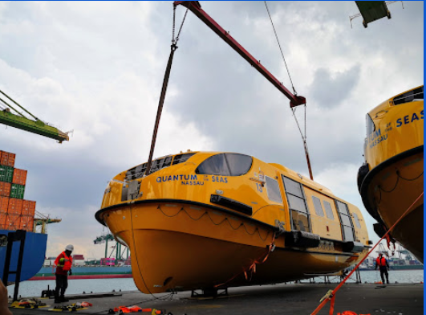
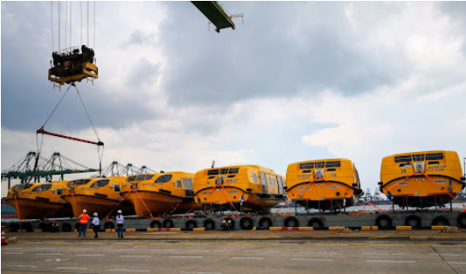
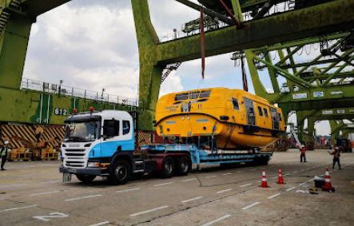
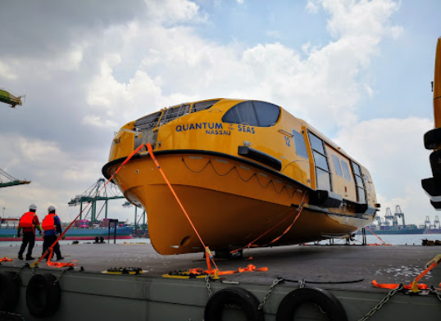
PROJECT REFERENCES
CASE STUDY – Barging of LIFEBOATS
Project Name: MASTER OF M QUANTUM OF THE SEAS
Cargo: Lifeboats
6 UNITS OF LIFEBOATS
TOTAL: 138,000.00 KGS / 2,612.166 CBM
Shipper: FR. FASSMER GMBH & CO. KG
Destination: MASTER OF M QUANTUM OF THE SEAS
Scope:
Direct receiving as BB cargo from container vessel and load on barge.
Delivery to Mega yard by barge.

