Slide 1

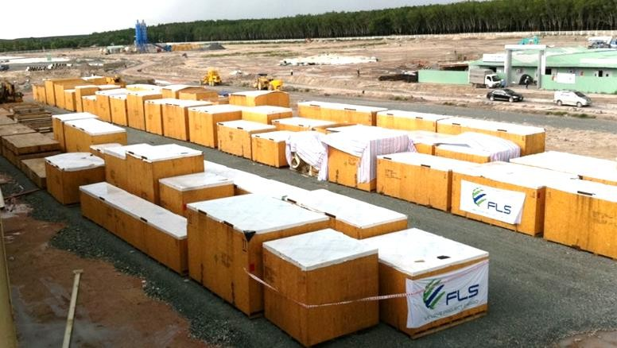
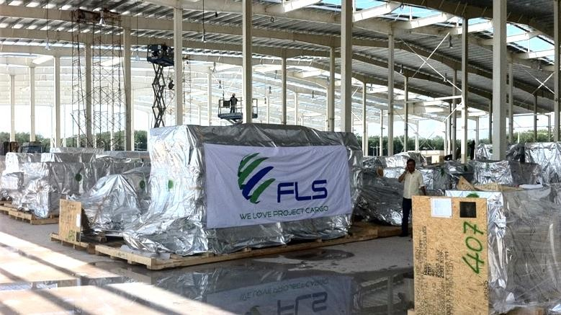
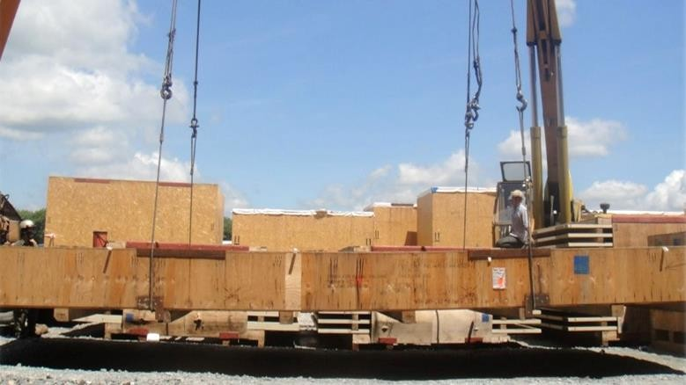
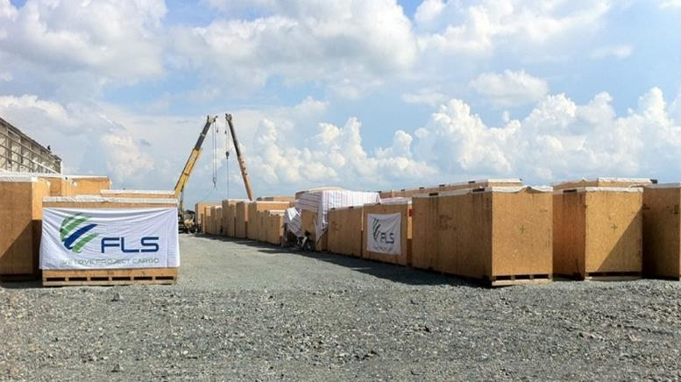
PROJECT REFERENCES
CASE STUDY – MDF PLANT PROJECT IN BINH DUONG
Project Name: Volume:
Origin:
Destination(POD):
FIRST MDF PLANT EVER BUILT IN VIETNAM
210 Containers + 9,500 cbm Breakbulk cargo Belgium, Sweden, Germany, Malaysia, China Ho Chi Minh City, Vietnam
Scope:
Handling and booking of the ocean freight for break bulk and containers ex all origins worldwide
Supporting the project owner to apply for tax exemption
/ Custom clearance for the whole project, clearing the cargo under Import quota
Co-ordination and supervision of discharging break bulk cargo from the heavy lift vessel to the storage yard at the port
Organizing of the trucking from HCMC port to the jobsite in Binh Phuoc for 9,500 cbm of break bulk and 210 containers
Unloading / unstuffing at the jobsite in accordance to the
storage laydown plan of the supplier

