Slide 1
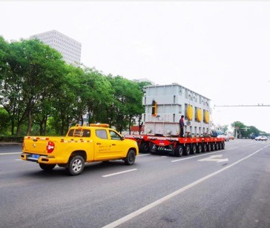
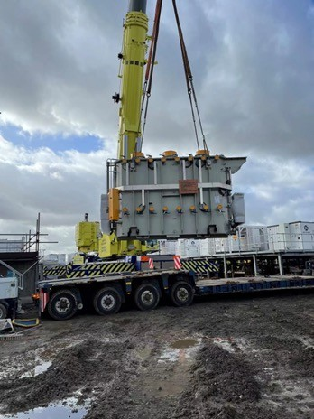
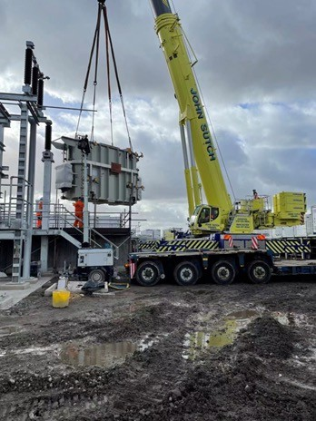
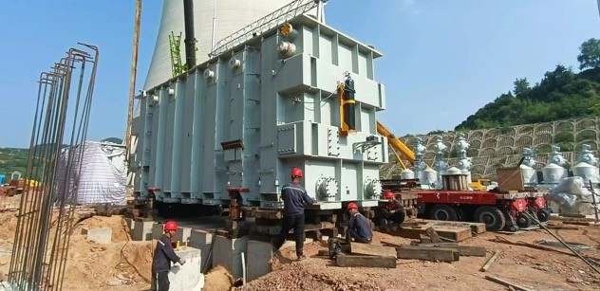
PROJECT REFERENCES
CASE STUDY – 350MT DOMESTIC TRANSPORT AND JACKING
Volume: Origin:
Scope:
350 tons heavy 1 package China
Transportation from factory to job site for Toshiba
Jacking and skidding from trailer onto trafo foundation
Jacking down onto foundation including alignment under the supervision by a FLS Project Manager

